Slide 1
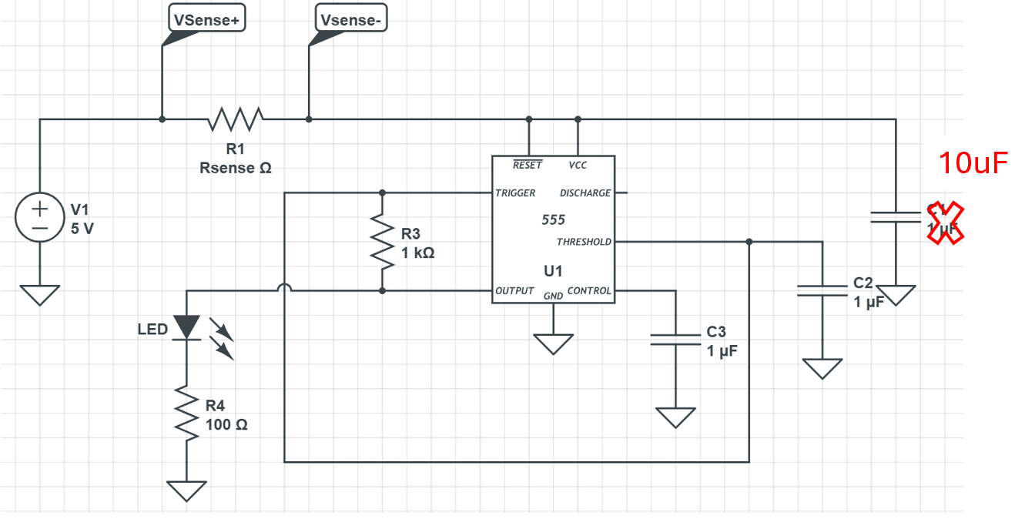
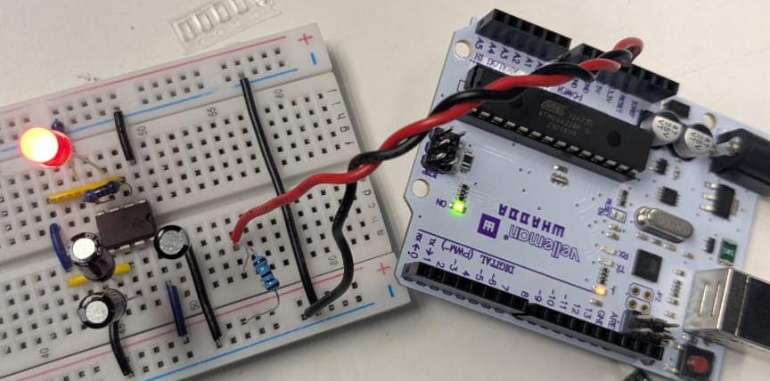
Lab 18 Findings
Joseph Abroquah
Data Collected: 10/10/2025
Goal: Measure inrush and steady-state current in a circuit
POR: The voltage between a 1 ohm resistor (sense resistor) placed between the power supply and the 555 timer circuit is measured using two single-ended oscilloscope probes and then Ohm's Law is used to calculate the current through the sense resistor.
Two single-ended scope probes (each referenced to ground) were used to measure the high and low sides of the resistor. The difference between these signals, computed by the scope’s math function, gives the voltage drop across the resistor.

Slide 2
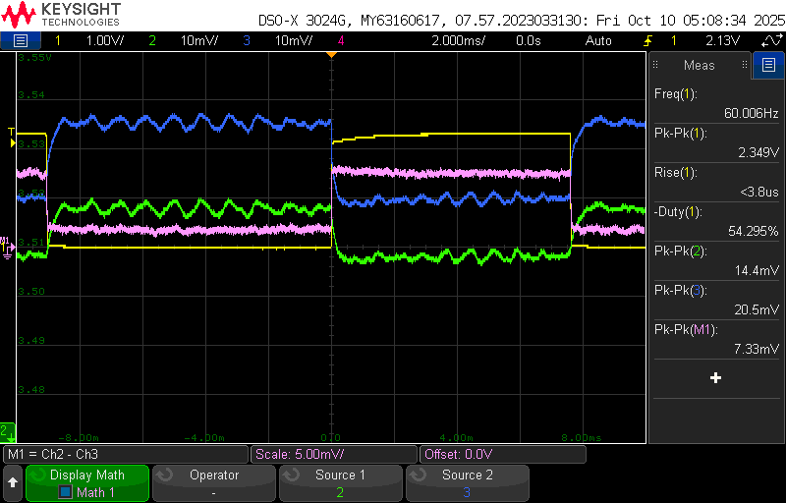
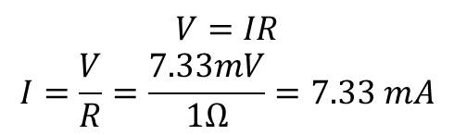
Results
Two 10x scope probes connected:
Probe 1: High side of the sense resistor
Probe 2: Low side of the sense resistor
Both referenced to the system ground
Steady-State Current Measurement
Observed voltage drop across sense resistor: ~7 mV which gives ~ 7mA
$$V=IR$$
$$I=\frac{V}{R}=\frac{7.33mV}{1Ω}=7.33 mA$$

Slide 3
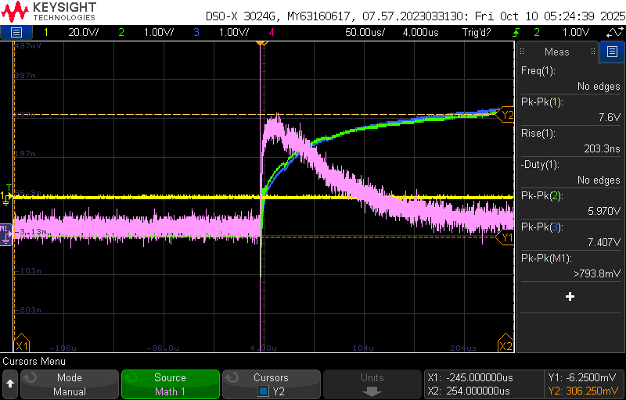

Results
To measure the transient inrush current:
  Scope set to Normal mode to trigger only on the event of power being applied
  Triggered on high-side resistor voltage exceeding ~1 V
  $I=\frac{7.407−5.970}{1}=1.4 A$
Key Findings
Two single-ended probes provide a means to measure a differential voltage which is used here to calculate the in-rush current
  Understanding in-rush and steady-state current is critical in system design
Magnitude of in-rush current is affected by value of decoupling capacitor
  More capacitance, higher magnitude of in-rush current

